Slide 1



Garbage Classification with EfficientNetV2B2

Slide 2

Learning Objectives
Understand image classification techniques for real-world problems.
Implement deep learning using TensorFlow and Keras.
Learn to use EfficientNetV2B2 for transfer learning.
Apply data preprocessing and augmentation methods.
Evaluate model performance using metrics like accuracy and loss.
GOAL
Source :
www.freepik.com/

Slide 3
Tools and Technology used
Python
TensorFlow and Keras
EfficientNetV2B2 (Transfer Learning)
Numpy,Matplotlib,Seaborn
Google Colab
Kaggle dataset
Gradio

Slide 4
Methodology
Data Acquisition
Collected and organized labelled image data from Kaggle.
Preprocessing
Resized,normalized and augmented images.
Model Building
Used EfficientNetV2B2 with transfer learning.
Training
Trained the model using categorical cross-entropy and adam optimizer
Evaluation
Plotted accuracy/loss curves, confusion matrix
Deployment
Built a UI using Gradio for user interaction

Slide 5
Problem Statement:
Manual garbage classification is inefficient, inconsistent, and error-prone. There is a need for an automated, intelligent classification system to improve waste sorting accuracy and efficiency.

Slide 6
Solution:
A deep learning-based garbage classification model using EfficientNetV2B2 architecture, which categorizes waste images into classes like cardboard, glass, metal, paper, plastic, and trash with high accuracy

Slide 7
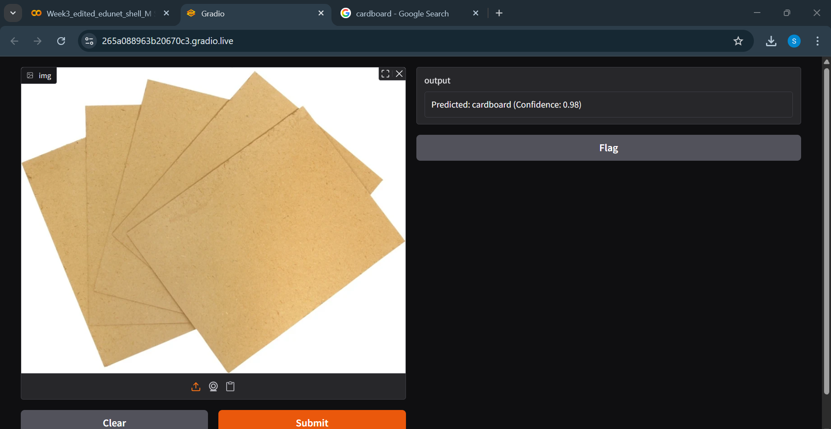
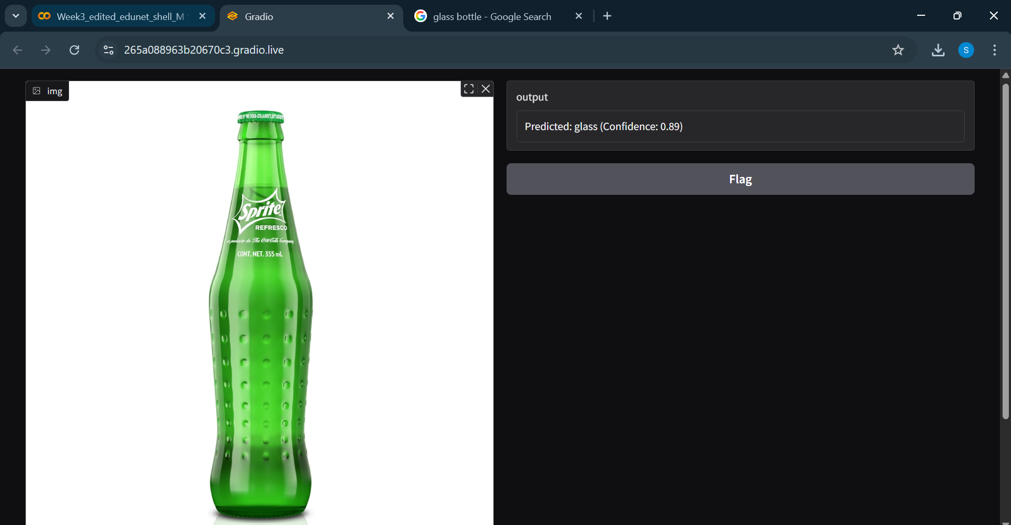
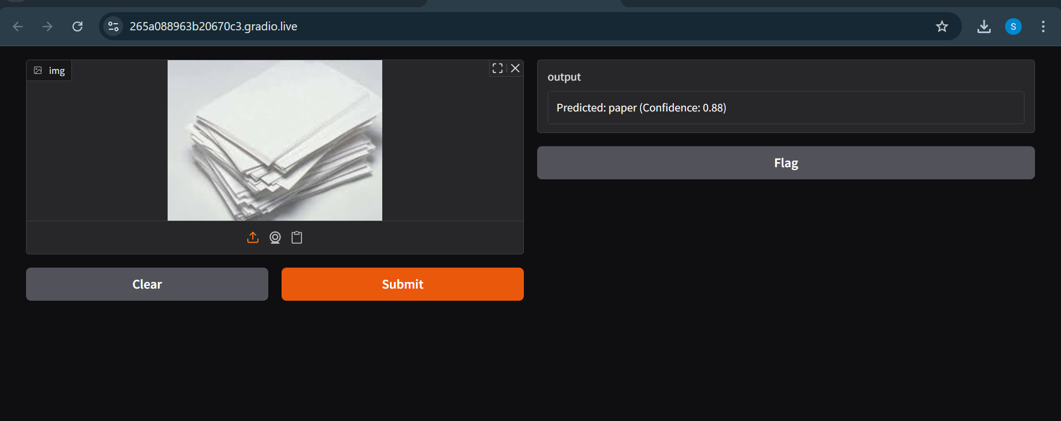
Screenshot of Output:

Slide 8
Conclusion:
Successfully implemented an image classification model for garbage detection.
Achieved good model performance and user-friendly deployment.
Promotes environmental sustainability by enabling smarter waste management solutions.
Can be further improved using larger datasets and real-time image capture systems.

